Slide 1
The microbial community is different (regardless of treatment and inflow):
Between rearing water, oyster larvae, and tank biofilms
Over time in water
Probiotics increase niche selection of certain bacteria from the water, especially proteobacteria, in the oyster larvae.
Amplification of certain taxa in treated larvae compared to control
Increased abundance and diversity of Vibrio spp. in the water, and changes in overall composition (succession of species)
Co-occurrence analysis suggests that probiotics alter the overall microbial community through associated bacteria
Notes:
Last bullet: implications for future probiotic development, co-culturing, how we evaluate a “good” probiotic

Slide 2
 | Trial 1 | Trial 2 | Trial 3
Sampling Days (0=spawn) | W:1,12 / OS:8,12 | W:1,9 / OS:6,9 | W: 5,8,12
Sample Types | Water, Swabs, Oysters | Water, Swabs, Oysters | Water
Water Filtered | 410-750ml | 7-10ml | 1300-1700ml
Trial Dates | July 11-30, 2012 | Jan 9-18, 2013 | June 3-17, 2016
Bacterial reads from 12 water samples | 1.3 million | 1.8 million | 5.7 million
Methods | MoBio extraction | MoBio extraction | Puregene extraction
16S region | v3v4 | v3v4 | v6
Notes:
Table xx. Summary of sequencing data and probiotic trial information

Slide 3
Percent survival figure adapted from Modak et al., in prep
Notes:
Figure xx. Percent survival data in all Trials.

Slide 4
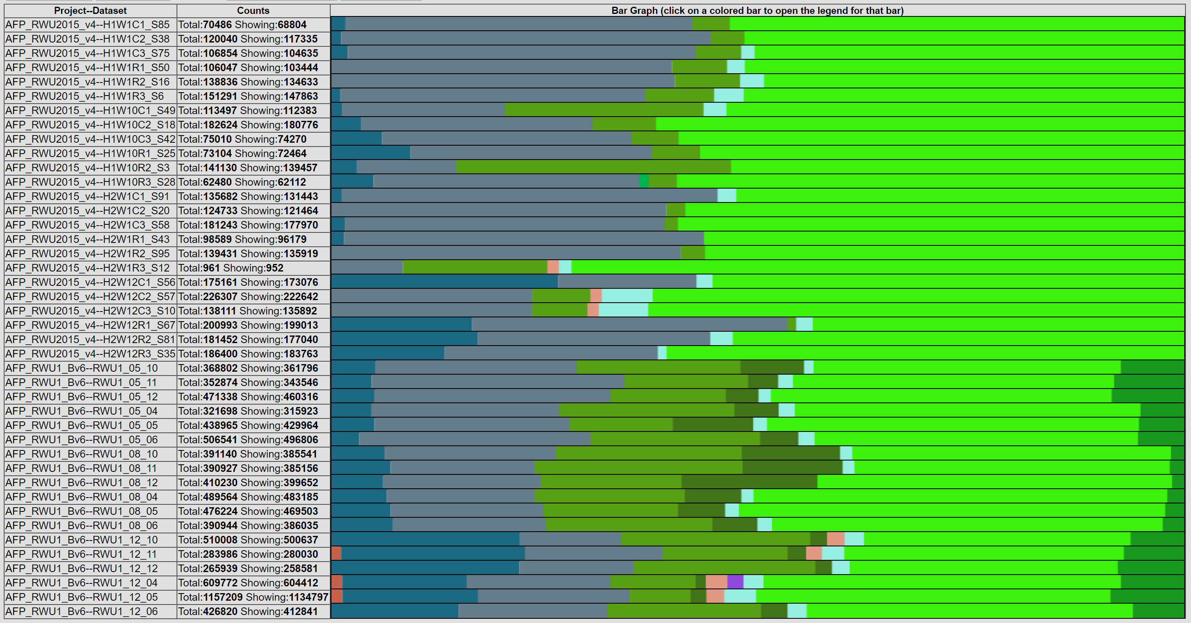
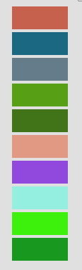
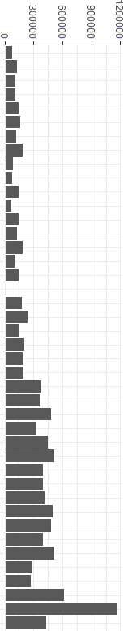
Trial
Day
Treat
Abundance
1
2
3
1
12
1
9
5
8
12
Con
B
Con
B
Acidobacteria
Actinobacteria
Bacteroidetes
Cyanobacteria
Deferribacteres
Firmicutes
Lentisphaerae
Planctomycetes
Proteobacteria
Unknown
Con
B
Con
B
Con
B
Con
B
Con
B
Notes:
Figure xx. Percent abundance in water samples by phylum shows small changes in the same system. Total abundance of reads is shown in the bar graph.
Decrease in Bacteriodetes
Increase in Acinobacteria

Slide 5
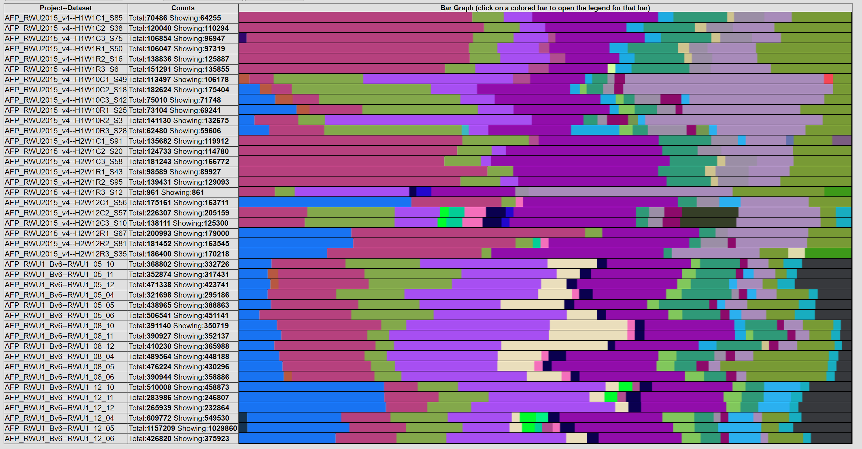
Trial
Day
Treat
Abundance
1
2
3
1
12
1
9
5
8
12
Con
B
Con
B
Con
B
Con
B
Con
B
Con
B
Con
B
Notes:
Figure xx. Percent abundance in water samples by order shows small changes in the same system. Total abundance of reads is shown in the bar graph.
Decrease in Bacteriodetes
Increase in Acinobacteria

Slide 6
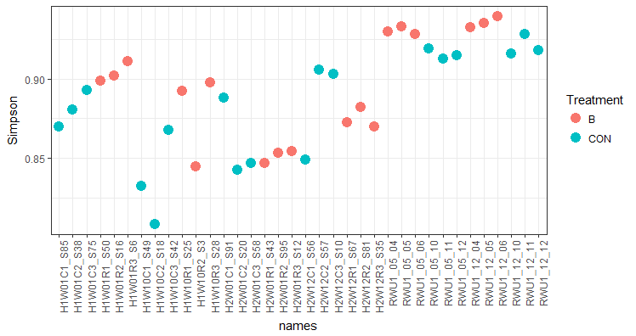
Simpson Diversity
Day 1 Day 12
Day 1 Day 9
Day 5 Day 12
Trial 1
Trial 2
Trial 3
Notes:
Figure xx. Simpson’s index of diversity for all water samples in all 3 trials.

Slide 7
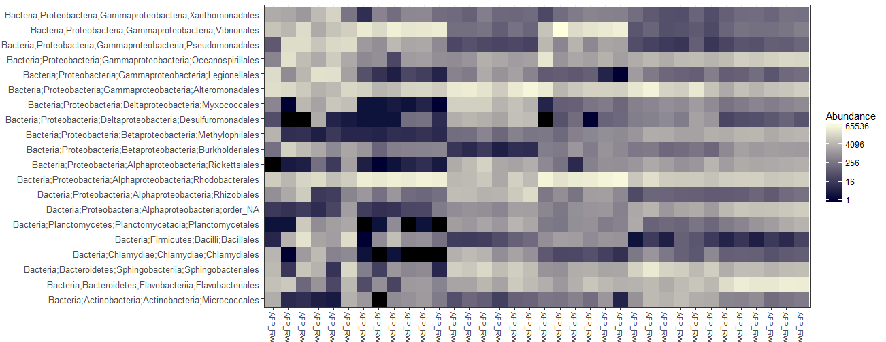
12 5
12 5
10 1
Oyster
Swab
Water
Notes:
Figure xx. The relative abundances of the 20 most abundant orders in Trial 1.

Slide 8
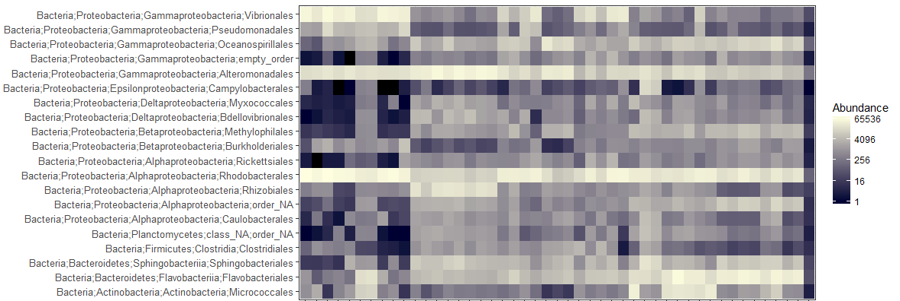
9 6
9 6
9 1
Oyster
Swab
Water
Notes:
Figure xx. The relative abundances of the 20 most abundant orders in Trial 2.
Supplementary?

Slide 9
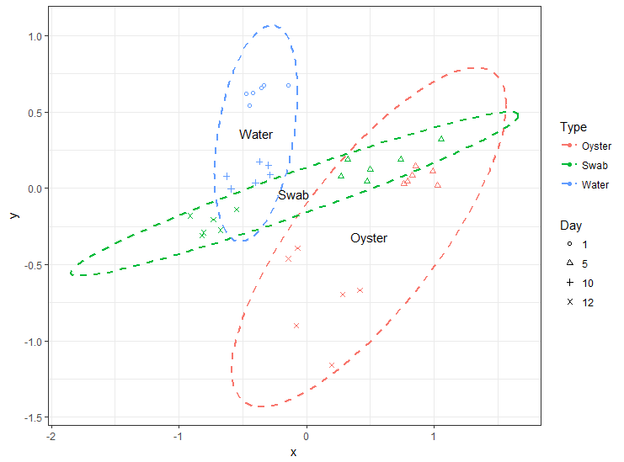
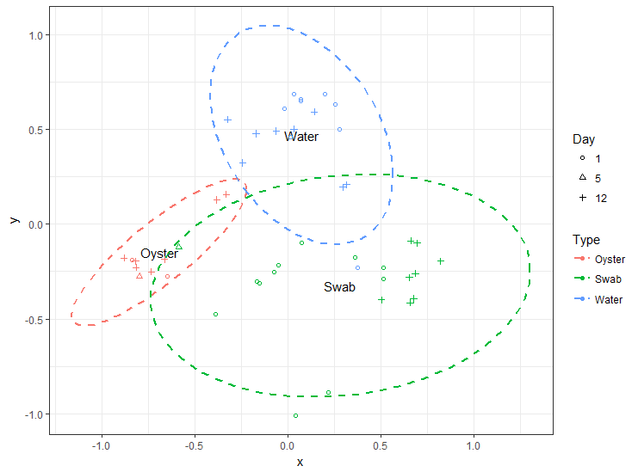
a) Trial 1
b) Trial 2
Notes:
Figure xx. NMDS plots of Bray-Curtis beta-diversity (k=2) for Trials 1 (a) and 2 (b). The different types of samples are indicated by colors and the days are indicated by symbols. The dotted lines show the 95% confidence interval.

Slide 10
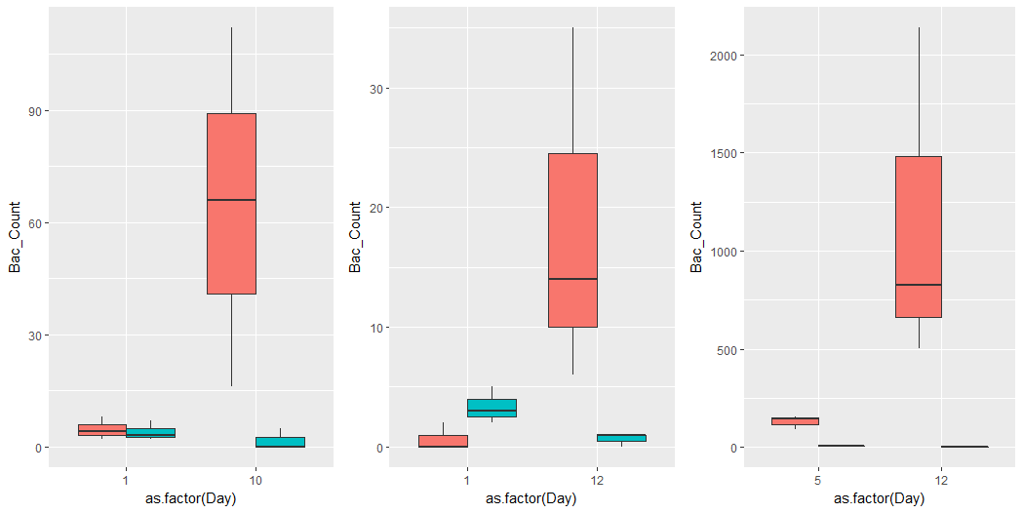
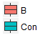
Trial 1
Trial 2
Trial 3
Treatment
Number of Bacillus Reads
Day 1 Day 12
Day 1 Day 9
Day 5 Day 12
Notes:
Figure xx. Number of Bacillus reads in treated and control samples on Days 1 and 12 (Trial 1), Days 1 and 9 (Trial 2), and Days 5 and 12 (Trial 3). n=3. Bacillus is consistently more abundant in the treated than the control water on Day 9/12 in all 3 trials.
Make y-axis the same. Swap Control/Bacillus

Slide 11
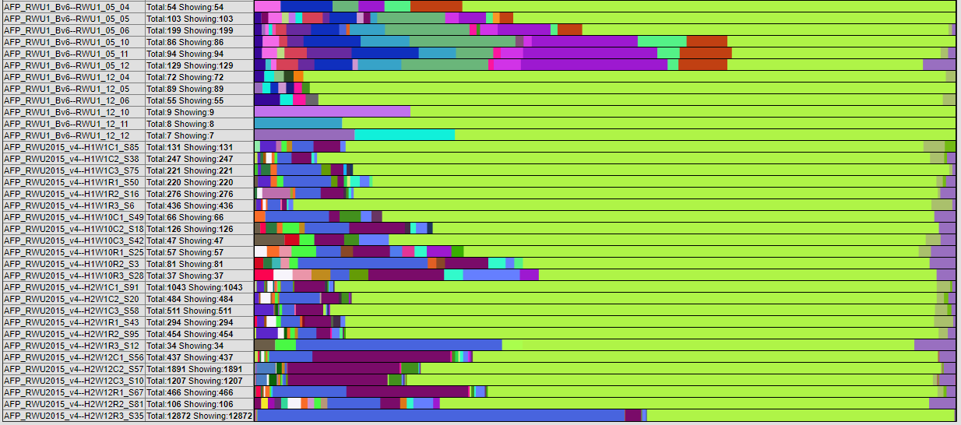
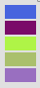
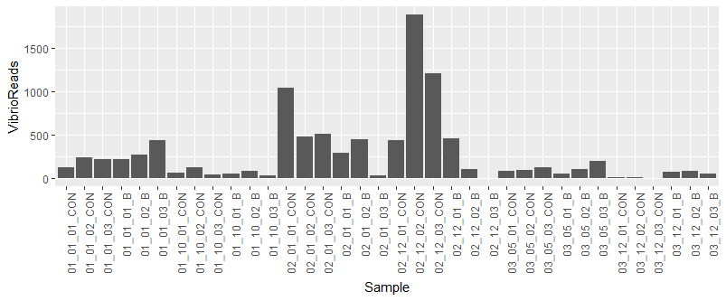
Trial
Day
Treat
1
2
3
1
12
1
9
5
12
Con
B
Con
B
Vibrio anguillarum
Vibrio diabolicus
Vibrio spp.
Vibrio splendidus
Vibrio vulnificus
Con
B
Con
B
Con
B
Con
B
Notes:
Figure xx. The total abundance and structure of Vibrio reads in all three trials. The structure of total Vibrio counts in the rearing water is different between Trials and changes over time.

Slide 12
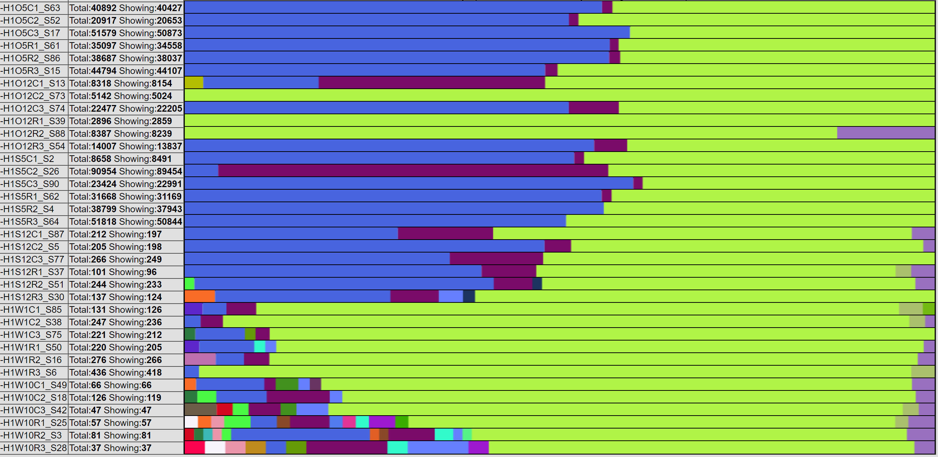
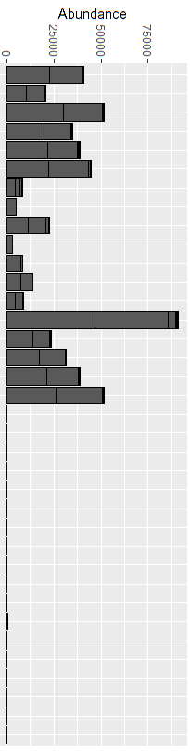
Sample
Day
Treat
Water Swab Oyster
5
12
5
12
1
12
Con
B
Con
B
Con
B
Con
B
Vibrio anguillarum
Vibrio diabolicus
Vibrio spp.
Vibrio splendidus
Vibrio vulnificus
Con
B
Con
B
Notes:
Figure xx. The structure of total Vibrios is different based on the sample type and time point in Trial 1.

Slide 13
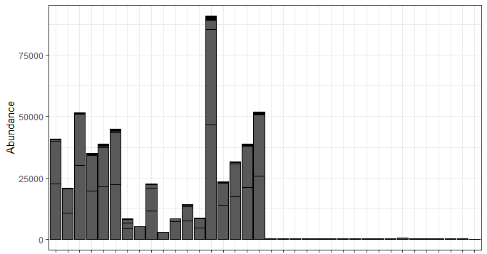
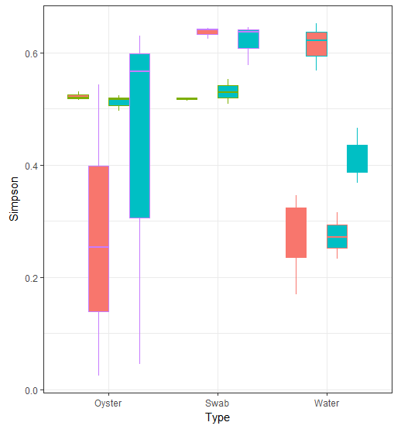
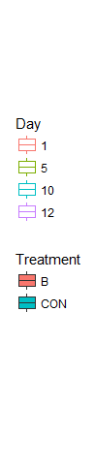
(a) Vibrio Read Abundance
(b) Vibrio Read Diversity
CON B CON B
CON B CON B
CON B CON B
Oyster
Swab
Water
5 12
5 12
1 12
Oyster
Swab
Water
Notes:
Figure xx. Total Vibrio read abundance and diversity in Trial 1. (a) Total Vibrio reads are most abundant in the oyster and swab samples. (b) Total Vibrio reads are the most diverse in the tank biofilms (swab) samples (Simpson’s index of diversity).
The oysters are selecting specific bacteria from the diverse water pool
Switch to scatterplot?

Slide 14
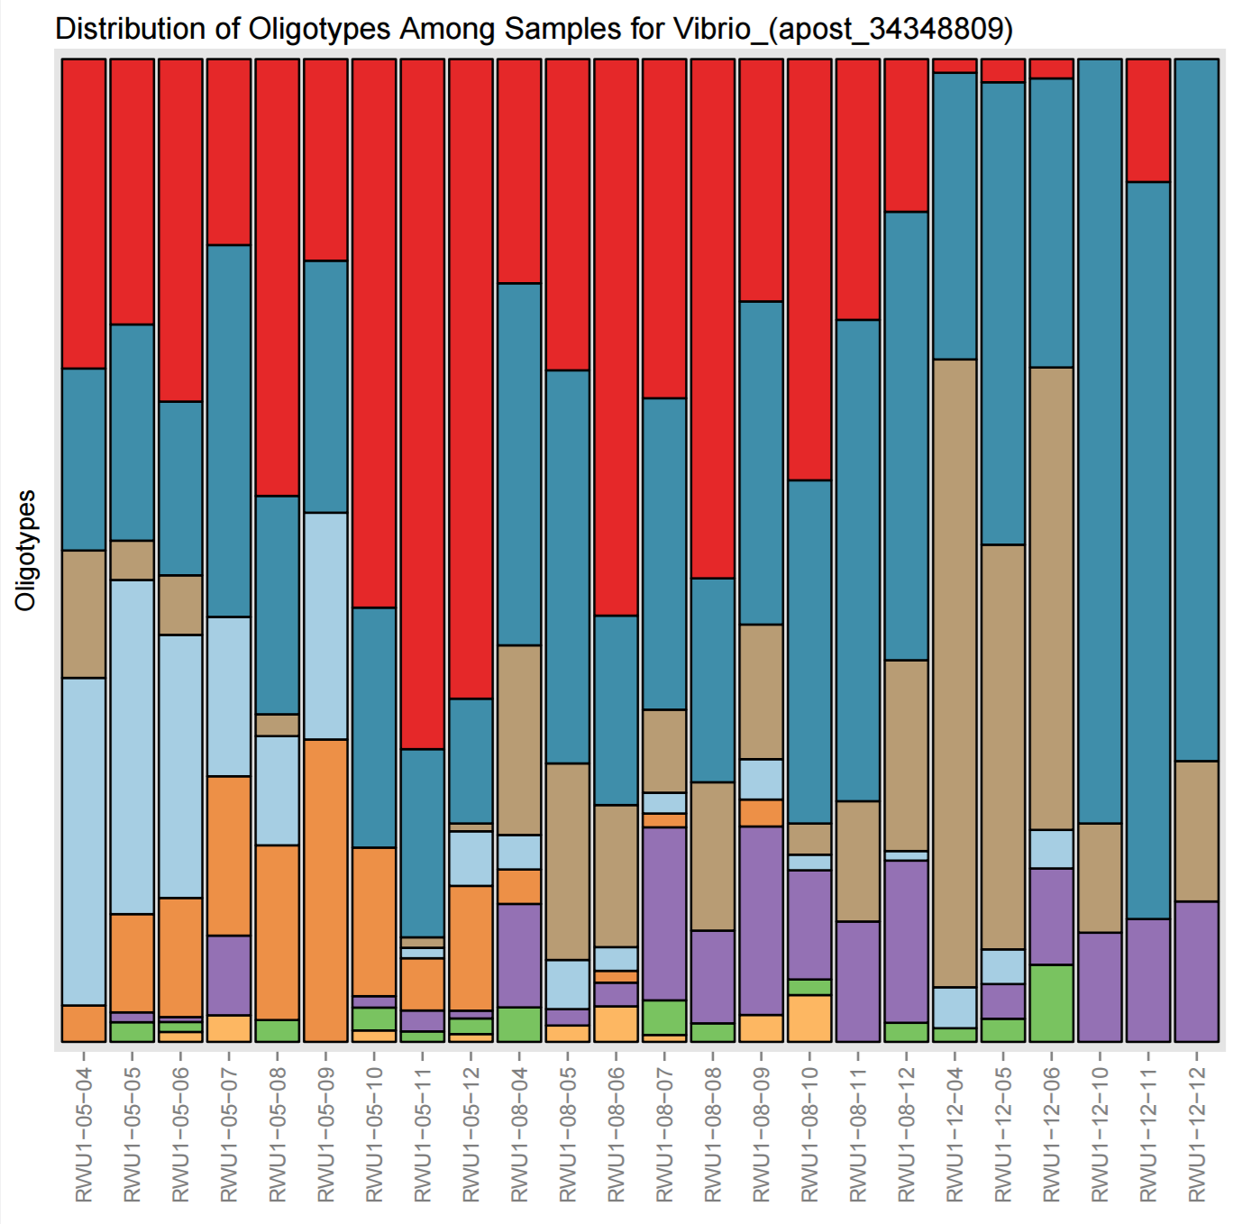
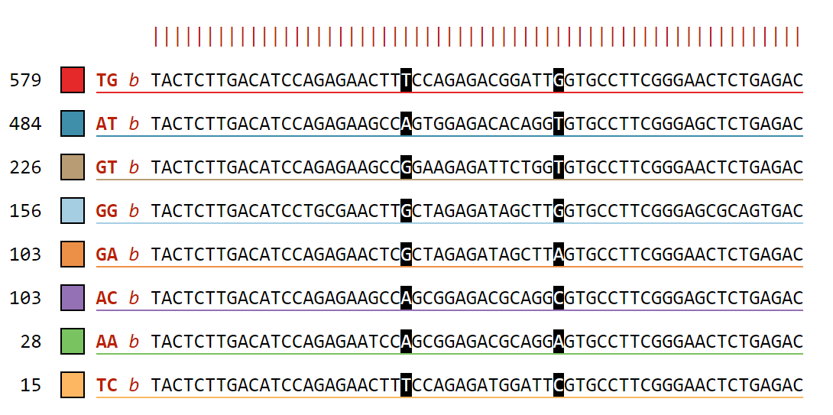
Positions 23, 37
in 1727 sequences
TG: Vibrio alginolyticus strain WW1 16S ribosomal RNA gene GenBank: KX425011.1
AT: Vibrio celticus partial 16S rRNA gene, isolate 5OM18 GenBank: LN832936.1
GT: Vibrio orientalis partial 16S rRNA gene, isolate LK2HaP4 GenBank: LT221239.1
GG: Halovibrio sp. strain 5F5 16S ribosomal RNA gene, partial sequence GenBank: KY636397.1
B CON B CON B CON
Day 5 Day 8 Day 12
Notes:
Figure xx. Vibrio Oligotyping reveals differences in succession of species over time between treatments in Trial 3.
GenBank: KX425011.1 - VIRULENT
GenBank: LN832936.1 - PATHOGENIC IN CLAMS
GenBank: LT221239.1 - ADAPTIVE FUNCTIONS

Slide 15
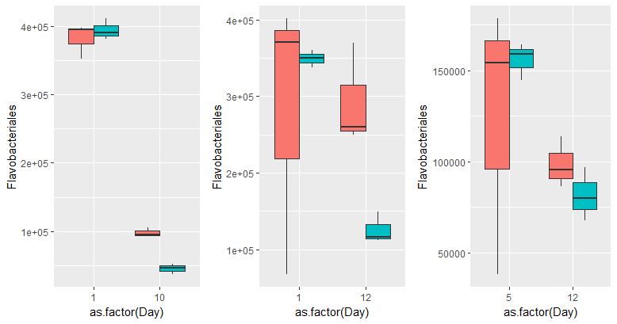
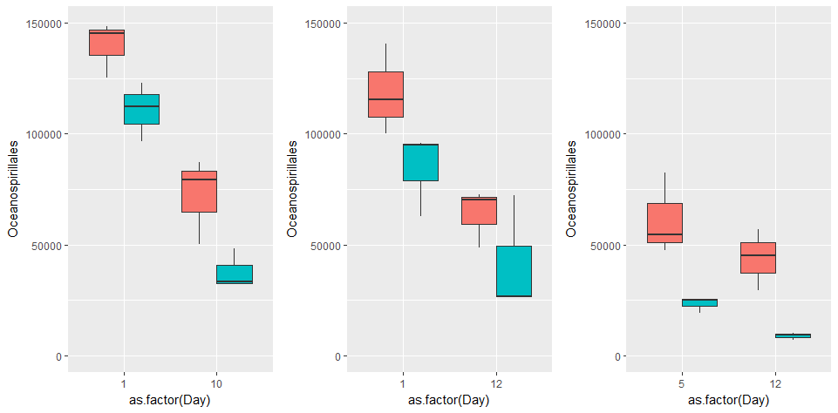
Trial 1
Trial 2
Trial 3
Day 1 Day 12
Day 1 Day 9
15
Day 5 Day 12
Treatment
Day 1 Day 12
Day 1 Day 9
Day 5 Day 12
Notes:
Figure xx. Read counts of Oceanospirallales and Flavobacteriales in all three trials over time, in both treated and control samples. Oceanospirallales and Flavobacteriales are consistently more abundant in probiotic-treated tank rearing water, and decrease with time.

Slide 16
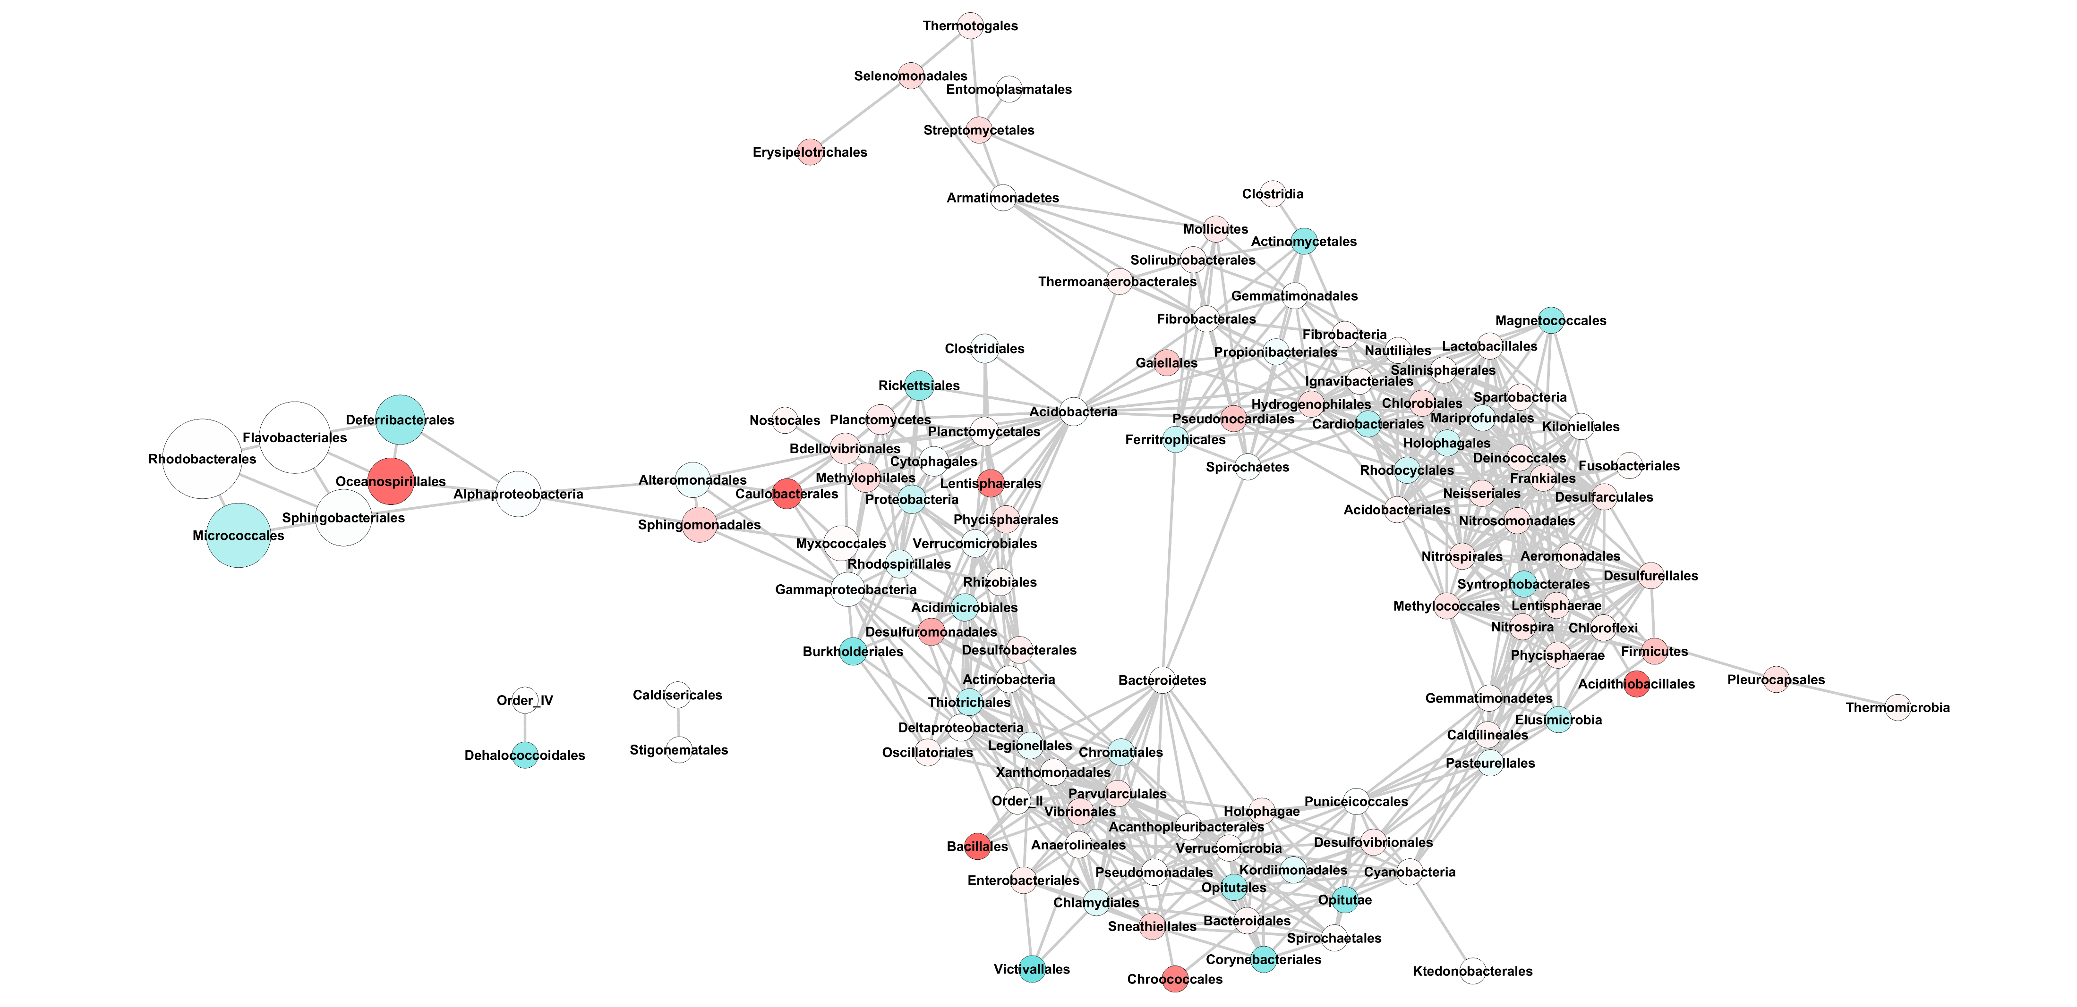
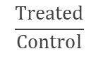
Occurrence
Number of Reads
22
1.0
0
2,720,000
1,350,000
675,000
2
$$\frac{Treated}{Control}$$
Notes:
Figure xx. Network analysis using Bray-Curtis dissimilarity metric (max distance =0.4, Order level).
Bootstrap this!
Blue (0) = Occurs in Control significantly more than Treated
White (1) = equal occurrence in treated and control
Very pink (22.05) = Only occurs in Control significantly more than Treated
Taxa that change in the same way will get an edge
Nodes that have edges occur in the same proportions, same samples

Slide 17
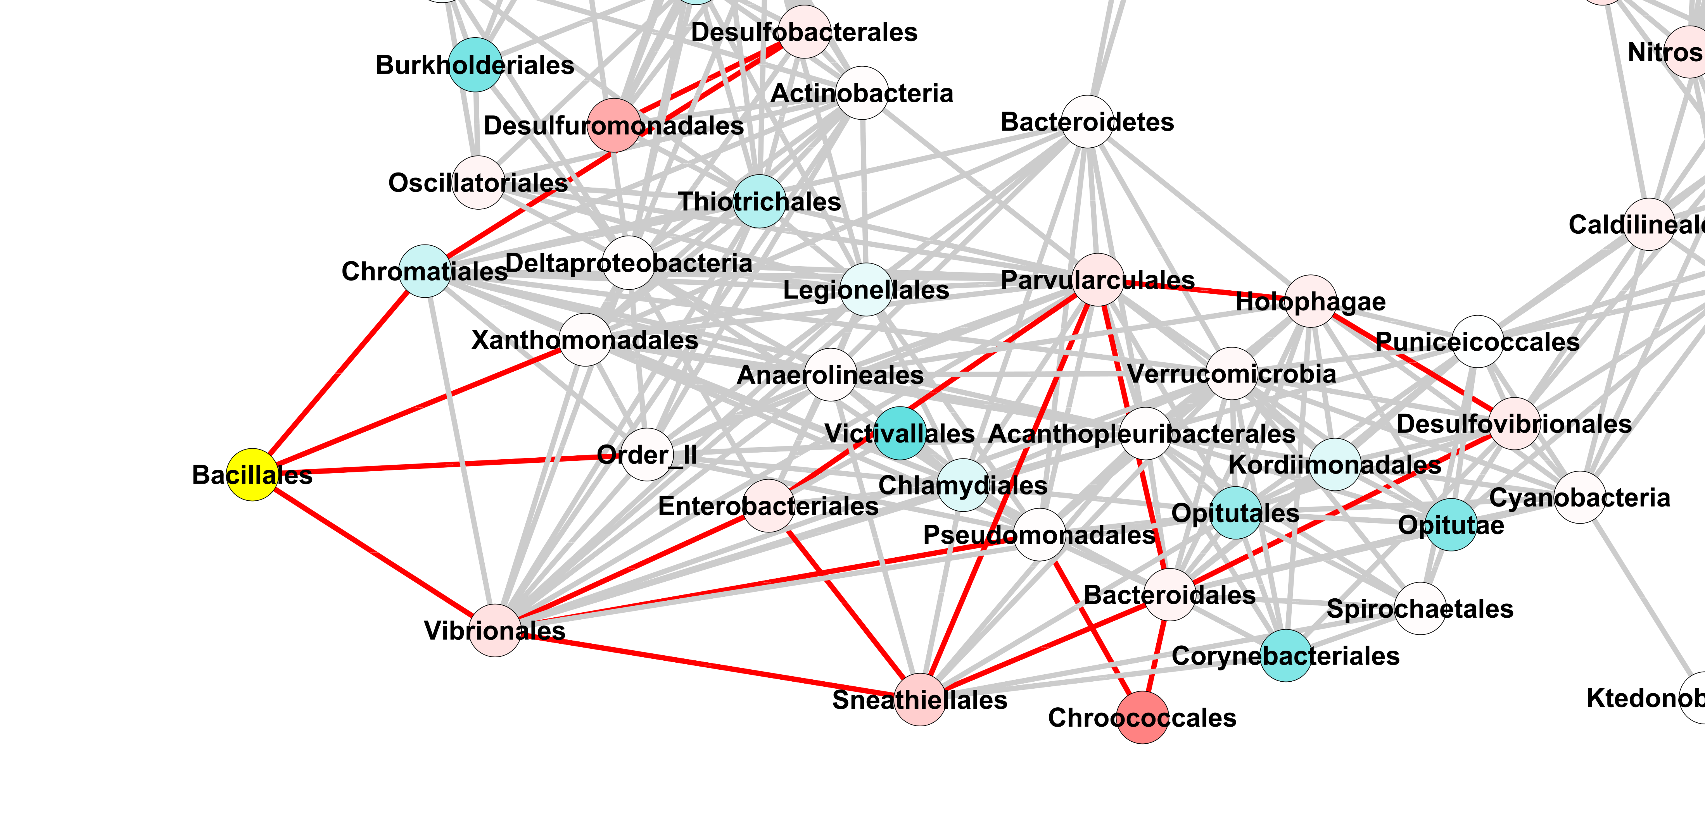
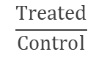
22
1.0
0
Proteobacteria;Gammaproteobacteria;Chromatiales
Proteobacteria;Gammaproteobacteria;Xanthomonadales
Bacteroidetes;Cytophagia;Order_II
Proteobacteria;Gammaproteobacteria;Vibrionales
$$\frac{Treated}{Control}$$
Notes:
Probiotic effect on the rearing water is mediated through select associated taxa.
Probiotics do not directly alter the rearing water microbial community, but act through associated bacteria.

Slide 18
Trial 1
Trial 2
Trial 3
Day 1 Day 12
Day 1 Day 9
18
Day 5 Day 12
Treatment
Day 1 Day 12
Day 1 Day 9
Day 5 Day 12
Notes:
Figure xx. Read counts of Oceanospirallales and Flavobacteriales in all three trials over time, in both treated and control samples. Oceanospirallales and Flavobacteriales are consistently more abundant in probiotic-treated tank rearing water, and decrease with time.

Slide 19
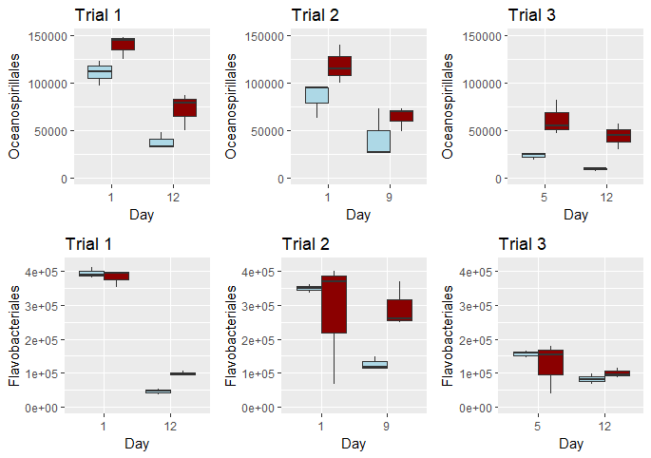
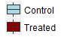
Treatment

